Slide 1


Slide 2
Ultima Atom -192
Product introduction

Slide 3


Slide 4


Slide 5


Slide 6
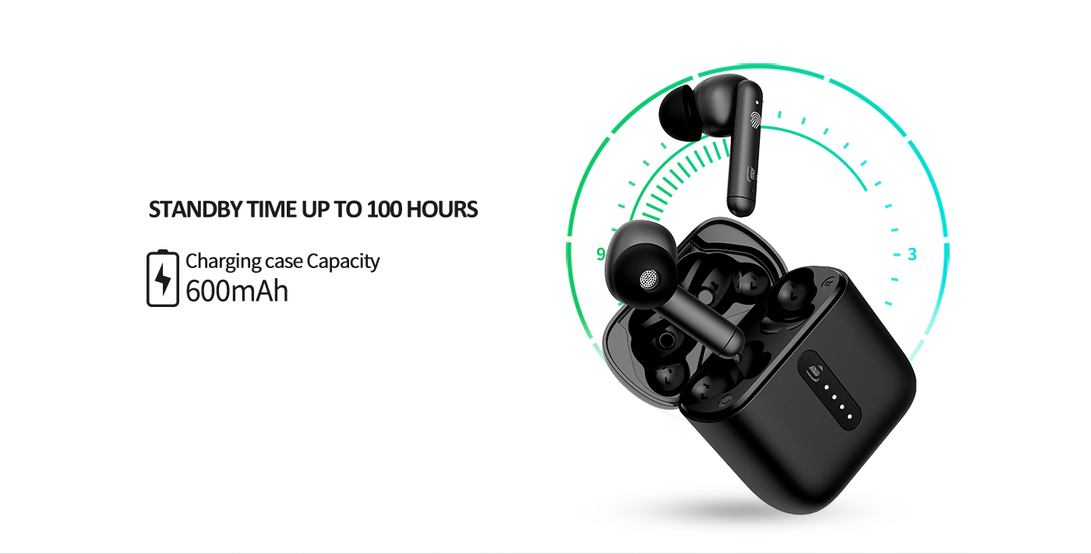
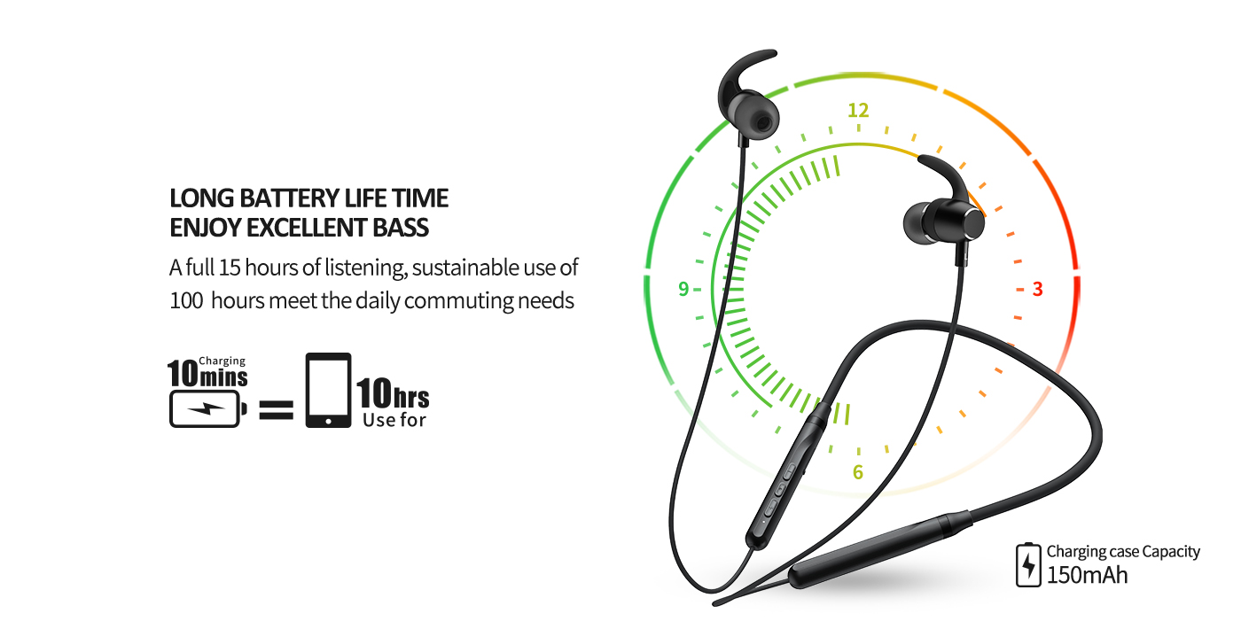


Slide 7
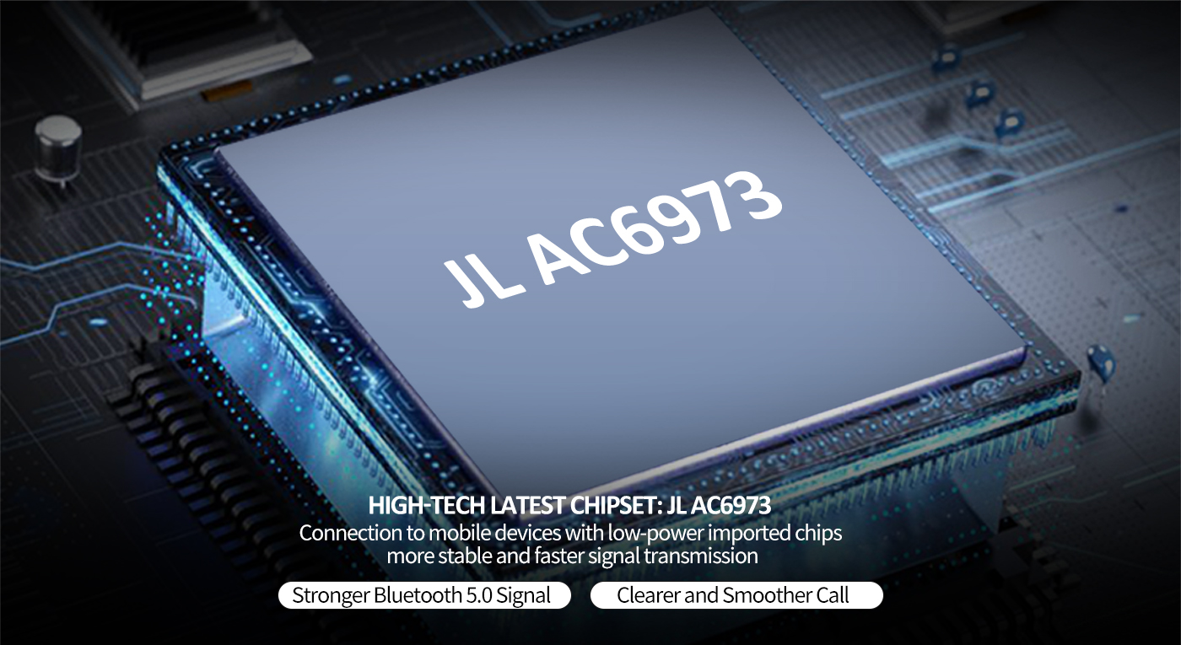

Slide 8


Slide 9


Slide 10
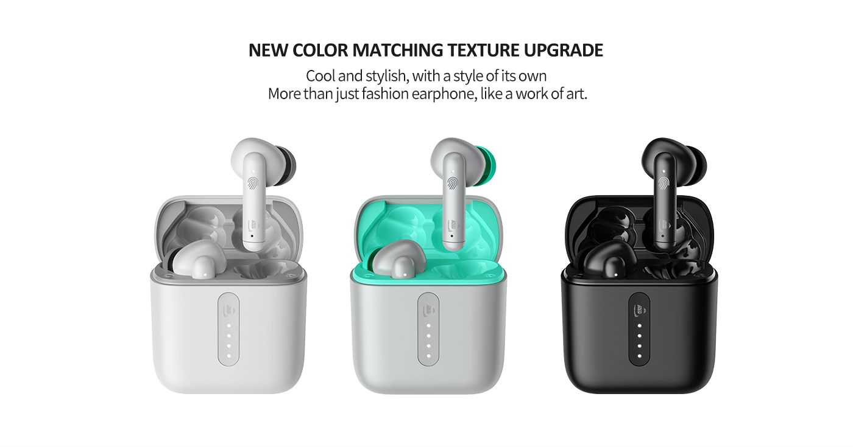

Slide 11
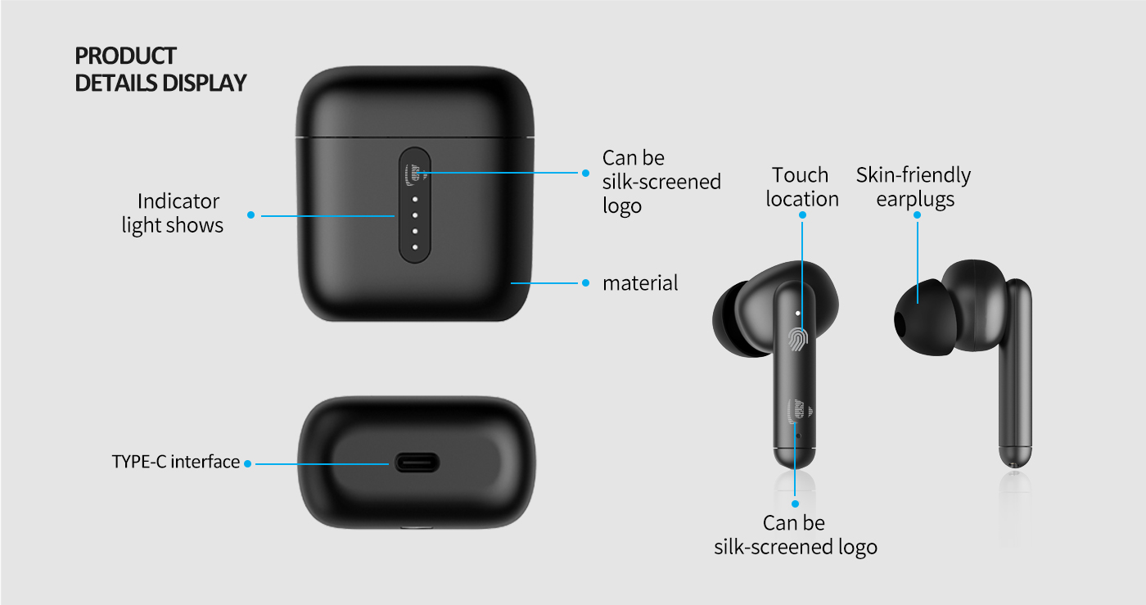


Slide 12


Slide 13


Slide 14
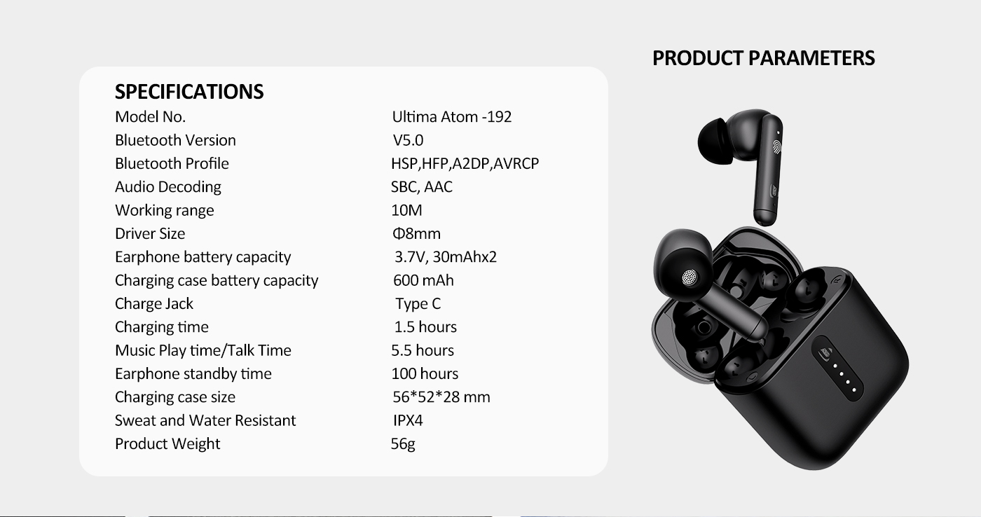

Slide 15
THANK YOU

